Slide 1

INTRODUCTION TO SQL SERVER

Slide 2

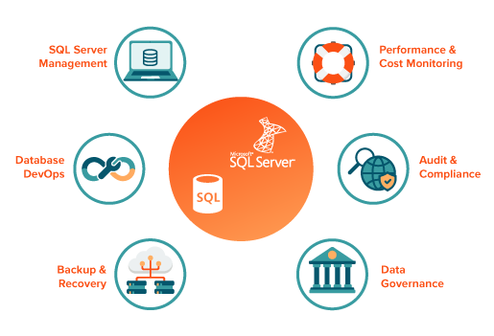

Slide 4
What is SQL Server
SQL Server is a relational database management system (RDBMS) from Microsoft. Database administrators (DBAs) and database developers connect business applications and tools to a SQL Server instance or database. They submit commands to SQL Server using a structured query language (SQL) called Transact-SQL, or T-SQL. As an RDBMS, SQL Server’s capabilities extend beyond the basics (definition, creation, query, update) of a DBMS. A database in an RDBMS stores data in tables that are related to one another; hence, it is relational. An RDBMS like SQL Server maintains relationships among tables using constructs such as foreign keys, Data Definition Language (DDL), Data Manipulation Language (DML) and Data Control Language (DCL).

Slide 5
Difference BWT MYSQL & SE SERVER
MySQL is the world’s most popular and widely used open-source relational database. It was originally founded and developed in Sweden by two Swedes and a Finn: David Axmark, Allan Larsson and Michael “Monty” Widenius, who had worked together since the 1980s.
Microsoft SQL Server is an RDBMS product that is often abbreviated to SQL Server. MySQL and SQL Server are direct competitors. MySQL is owned by Oracle and uses a different code base than traditional Oracle Databases.

Slide 6
Is SQL Server a database ?
Microsoft SQL Server is a relational database management system. As a database server that stores and retrieves data as requested by other software applications on the same computer or a remote computer using the client-server model. Microsoft provides APIs to access SQL Server over the internet as a web service. An RDBMS does a lot more than get data for client applications. Internal functions such as buffer management ensure the most accessed data is available in the fastest form of available storage to speed access.
SQL Server is based on the relational model and also enforces referential integrity between objects to maintain data consistency. As with other relational databases, the principles of atomicity, consistency, transaction isolation and durability, collectively known as the ACID properties, are implemented to maintain integrity.

Slide 7
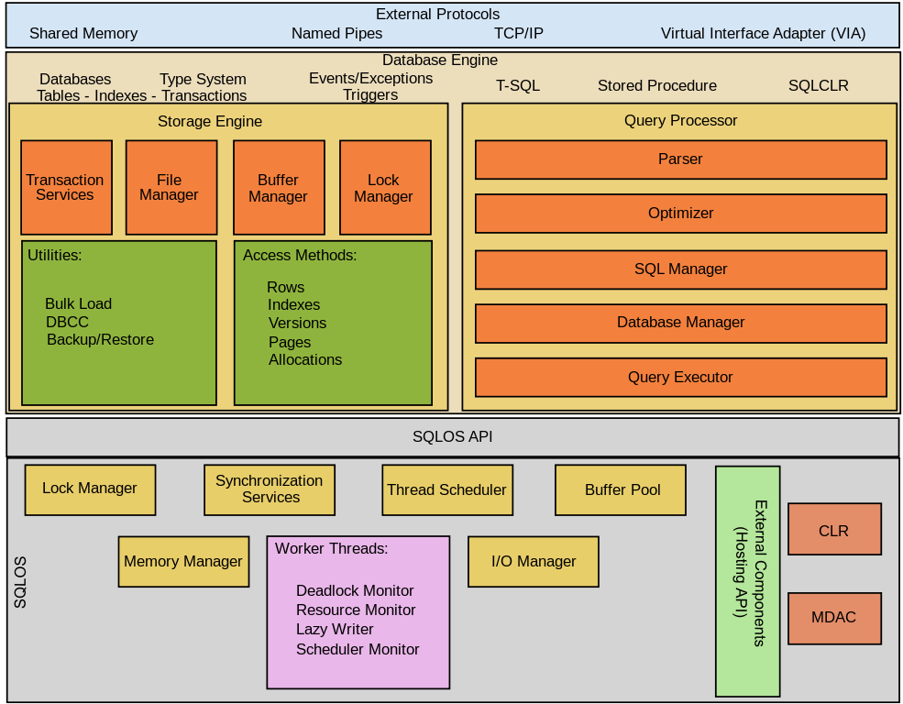
SQL Server Architecture

Slide 8
SQL Server Installation
https://www.microsoft.com/en-us/sql-server/sql-server-downloads

Slide 9
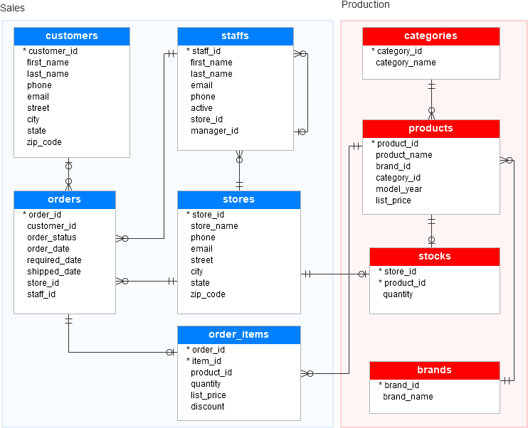
SQL Server Database

Slide 10
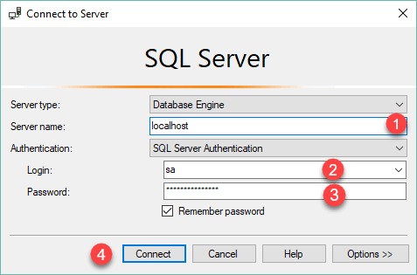
Load Database
https://www.sqlservertutorial.net/wp-content/uploads/SQL-Server-Sample-Database.zip
Step 1

Slide 11
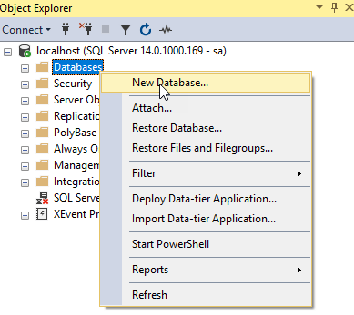
Load Database
Step 2

Slide 12
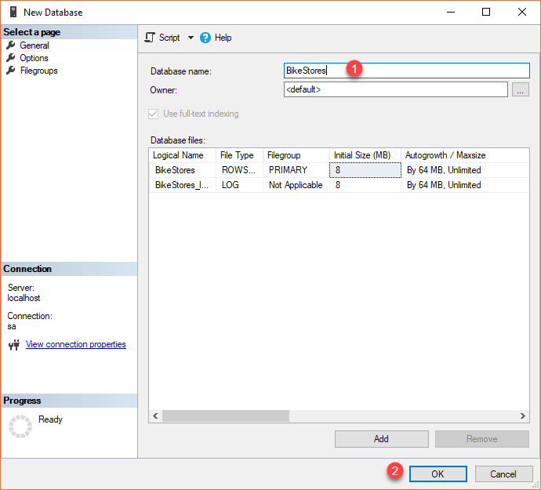
Load Database
Step 3

Slide 13
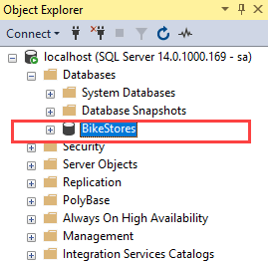
Load Database
Step 4

Slide 14
Load Database
Step 4

Slide 15
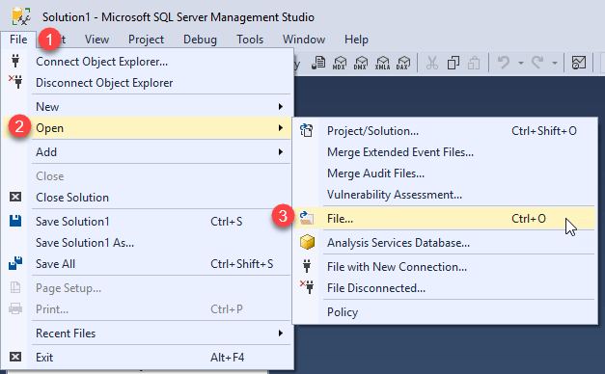
Load Database
Step 4

Slide 16
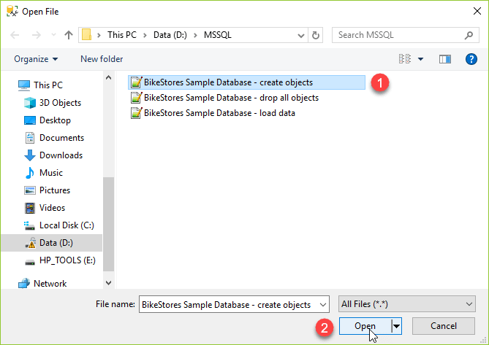
Load Database
Step 4

Slide 17
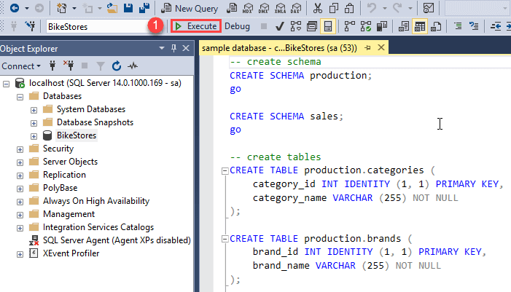
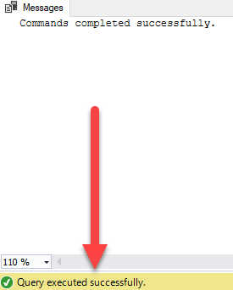
Load Database
Step 4

Slide 18
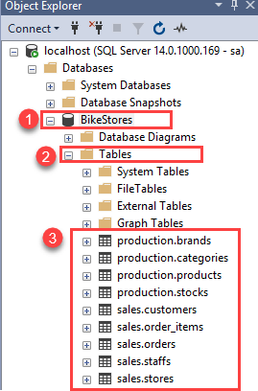
Load Database
Step 4

Slide 19
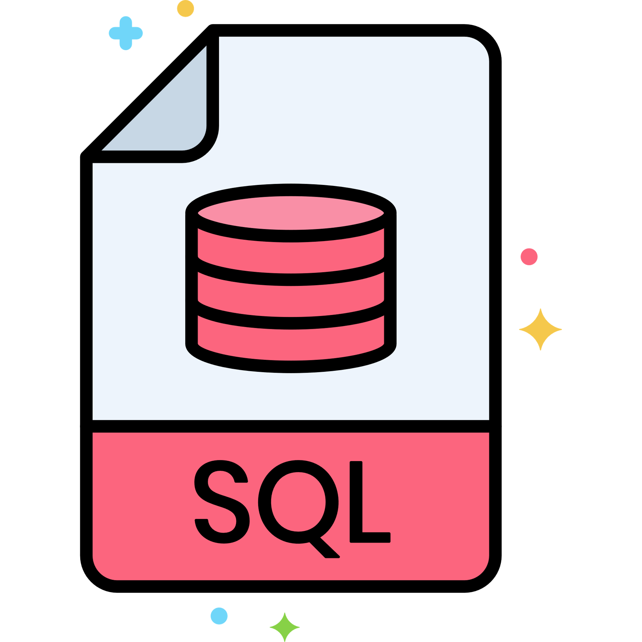


Slide 20
QUERYING Data
SELECT

Slide 21
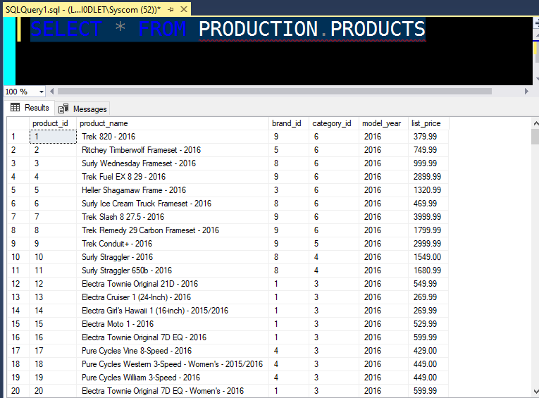
Querying Data
SQL Server SELECT

Slide 22
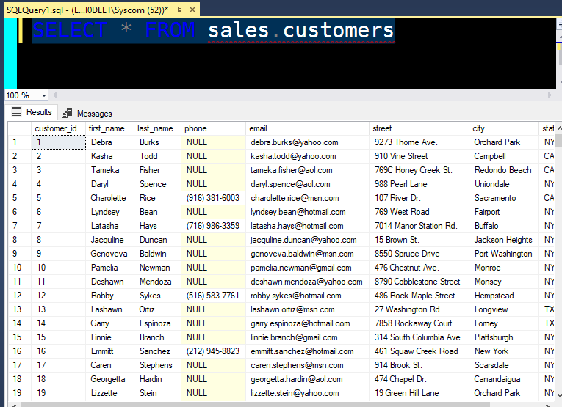
Querying Data
SQL Server SELECT

Slide 23
SORTING Data
ORDER BY

Slide 24
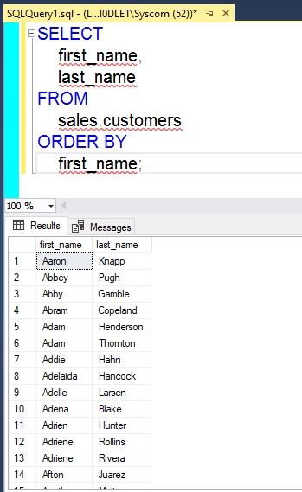
SORTING Data
ORDER BY
Sort a result set by one column in ascending order

Slide 25
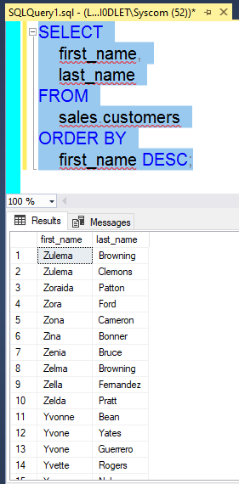
SORTING Data
ORDER BY
Sort a result set by one column in descending order

Slide 26
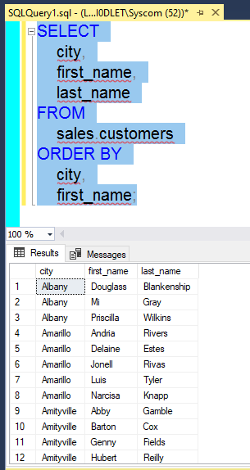
SORTING Data
ORDER BY
Sort a result set by multiple columns
The following statement retrieves the first name, last name, and city of the customers. It sorts the customer list by the city first and then by the first name

Slide 27
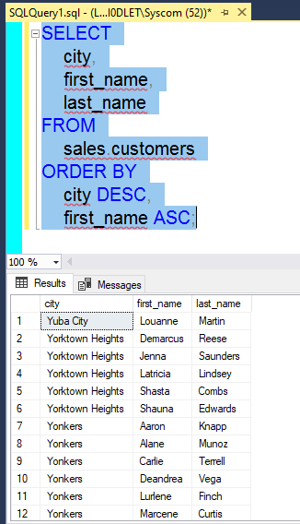
SORTING Data
ORDER BY
Sort a result set by multiple columns and different orders
The following statement sorts the customers by the city in descending order and then sorts the sorted result set by the first name in ascending order.

Slide 28
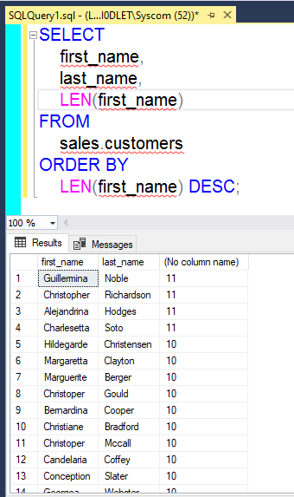
SORTING Data
ORDER BY
Sort a result set by an expression

Slide 29
LIMITING ROW
OFFSET FETCH

Slide 30
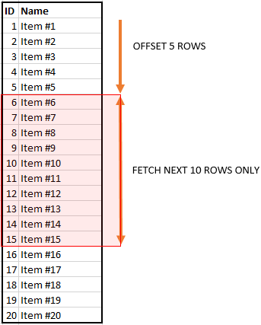
LIMITING ROW
OFFSET FETCH
limit the number of rows returned by a query.
The OFFSET and FETCH clauses are the options of the ORDER BY clause. They allow you to limit the number of rows to be returned by a query.

Slide 31
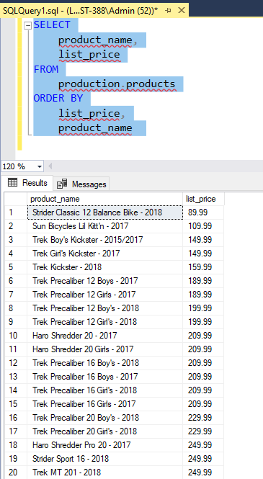
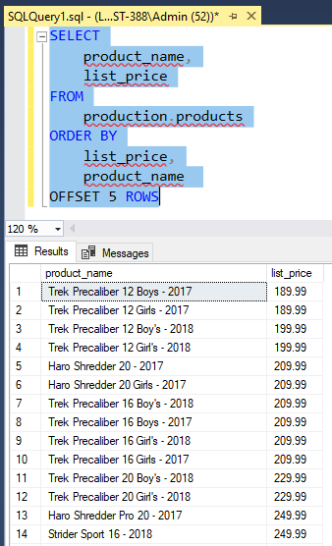
LIMITING ROW
OFFSET FETCH
To skip the first 10 products and return the rest, you use the OFFSET clause

Slide 32
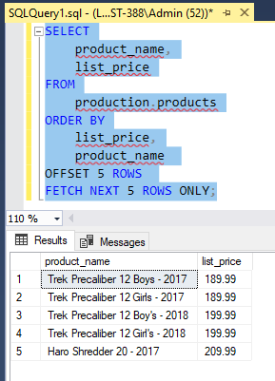
LIMITING ROW
OFFSET FETCH
To skip the first 10 products and select the next 10 products, you use both OFFSET and FETCH clauses as follows:

Slide 33
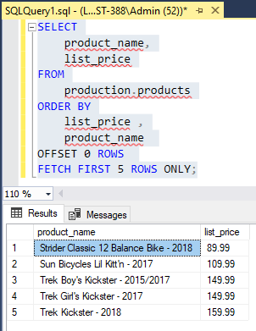
LIMITING ROW
OFFSET FETCH
Using the OFFSET FETCH clause to get the top N rows

Slide 34
ALIASES
LIKE
BETWEEN
FILRTING ROW
IN
DISTINCT
WHERE
AND
OR

Slide 35
FILTRING ROW

Slide 36
JOINING TABLE

Slide 37
GROUPING TABLE

Slide 38
SUBUERIES

